Slide 1
Welcome to Seesaw!

Slide 2
Objectives
At the end of this session, you will be able to:
recall Russell’s technology goal
list three creative tools within Seesaw
set your classroom up for Seesaw
list two ways you will implement Seesaw in your classroom

Slide 3
Agenda
View Cobb County & Mrs. Watson’s Technology Vision
Intro to Seesaw
Explore as a student
Ways to use Seesaw
Set up class
Questions and next steps
Survey

Slide 4
Cobb County and Mrs. Watson’s Technology Vision
Prepare digital age learners for success in a global, ever-changing society by promoting….
creativity
higher order thinking
problem-solving skills
“My vision is for teachers to find ways to engage students through technology (Tammy Watson, personal communication, September 10, 2018).

Slide 5
Using Seesaw will support Cobb County’s vision by giving students the opportunity to learn through experience.
Learning through experience requires students to use creativity, higher order thinking, and problem-solving skills.
Seesaw will also keep students engaged and help increase motivation, self-esteem, and students’ interest.

Slide 6
What is Seesaw?
Digital portfolio that allows students to display their work with their teacher as well as their family.
Students are able to share the following with Seesaw:
Pictures
Drawings
Videos

Slide 7
Seesaw’s Mission
“Seesaw’s mission is to create an environment where students can be their best. To accomplish this goal, it is essential that Seesaw is safe place for students to document their learning, and that parents and teachers are in complete control over how that information is shared.”
Seesaw promises the following:
We never sell your data or student data.
We never advertise in Seesaw.
We don’t own the content you add to Seesaw.
Student work is private to the classroom by default.
We use the latest security industry best practices to protect you.
We are transparent about our practices and will notify you if things change.
We are compliant with FERPA, COPPA, and GDPR.
Seesaw https://web.seesaw.me/terms-of-service

Slide 8
Target Population
Seesaw is accessible for students in grades K-12.
A 1:1 technology model would be perfect for this classroom, but it will work with any school that has technology within the classroom.

Slide 9
How to access Seesaw?
Seesaw can be access by downloading the app onto iOS devices, Chromebooks, Android devices, and kindle fire.
You can also access Seesaw through PCs.

Slide 10
How does Seesaw Promote Learning?
Seesaw allows teachers to do the following to promote specific learning within the classroom;
Find or create learning activities for the entire class
Find or create learning activities for the entire specific students
Upload videos to introduce or clarify a standard
Upload pictures and worksheets

Slide 11
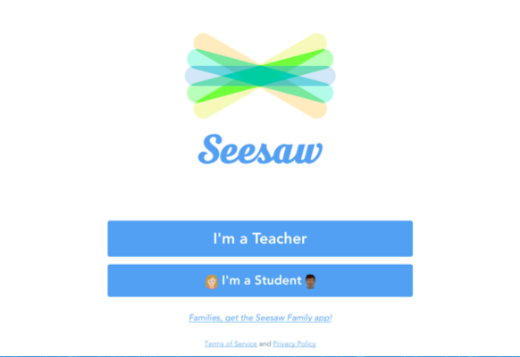
Let’s Experience Seesaw as a Student

Slide 12
Click I’m a Student

Slide 13
Scan QR Code

Slide 14
Let’s look at our first creative tool
+

Slide 15
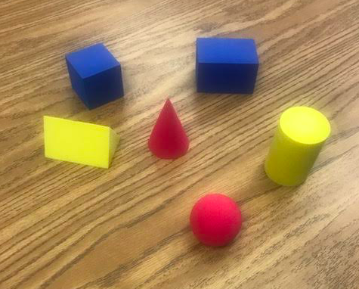
Find a 3D shape in the room

Slide 16
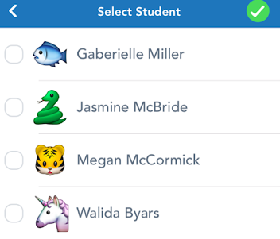
1.Click on the check to add to your portfolio.
2. Find your name.

Slide 17
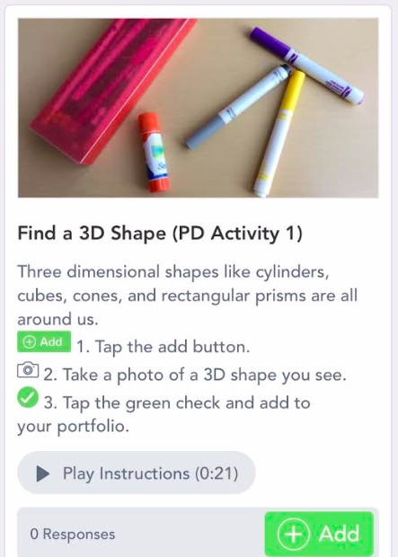
Find this activity
Tap here!

Slide 18
Let’s check in live with our class!

Slide 19
You just did your first activity!

Slide 20
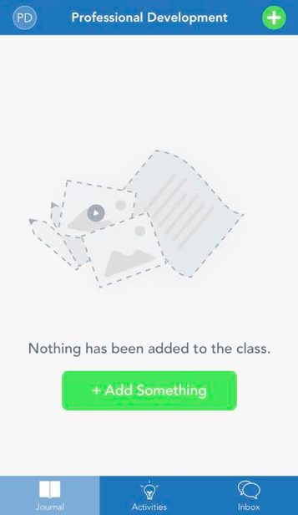
Let’s try another one
Tap here!

Slide 21
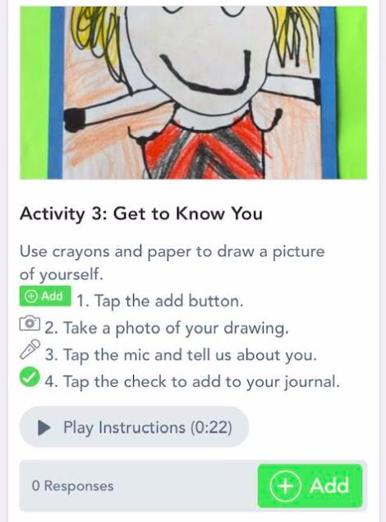
Find this activity
Tap here!

Slide 22
Find your name.

Slide 23
Was to use Seesaw
Seesaw could be used to meet a plethora of content standards.
Teachers would find or create a learning activity they want to assess and share it with their students via the Seesaw app.
Students complete the learning task and upload it to the app by taking a picture, drawing, or recording a video.
Right away teachers can view their students work and families can see their child’s work.
Teachers are able to provide feedback and parents are able to leave comments and encouragement.

Slide 24
Example
After teaching the content standard (S2E2. d) describe, illustrate, and predict how the appearance of the moon changes over time in a patterns. ISTE standards 1. Empowered Learner (1c and 1d), 2. Digital Citizen (2a-2d) and 6. Creative Communicator (6a and 6d).
Using the Seesaw app, students will do the following:
Students will illustrate the different phases of the moon using the drawing feature of Seesaw.
Next, students will describe the phases of the moon using the microphone feature (speaking domain).
Afterward, students will predict the next stages utilizing the writing feature (writing domain).
Finally, students will upload their work.
Differentiation:
Provide pictures of the moon and have students describe the phases of the moon.
Predict the next phase of the moon by picking from a selection of pictures.
Use the voice feature for the task.

Slide 25
Example cont.
The lesson presented showed how Seesaw can
enhance student engagement and support authentic learning
help a teacher plan a lesson that requires students to use critical thinking skills to create the end product
how to integrate technology standards to create innovative learning environments.
promote communication skills among students, parents, and teachers
be used to share students’ work globally via Seesaw blog
Teachers can take the example above and adapt it to their needs of their learners within their classroom.

Slide 26
Let’s Experience Seesaw as a Teacher

Slide 27
Technical Support
Teachers can get support through an open support chat or by submitting a help request through their help center.
There is also an “Ask a Question” feature with resources to assist with common questions about getting started, troubleshooting, and some other topics.
There isn’t any specific technical support listed for students. The teacher will have to assist them as needed.

Slide 28
Limitations
To set up a Seesaw account, teachers must first create a class roster. After building the list, teachers are given the option to create a class QR code or Text code. It is critical for teachers to understand that the codes are for classroom use only. Teachers should not send codes home to parents or share the information on social media. If they do, other people are able to sign into the class.

Slide 29
Questions and Next Steps

Slide 30
Survey

Slide 31
References
8 Critical Change Management Models to Evolve and Survive. (2017). https://www.process.st/change-management-models/
App Store Preview. (2018). https://itunes.apple.com/us/app/seesaw-the-learning-journal/id930565184?mt=8
Instructional Technology . (2017). http://www.cobbk12.org/centraloffice/InstructionalTechnology/
ISTE STANDARDS FOR STUDENTS. (2018). https://www.iste.org/standards/for-students
Roblyer, M. D., & Hughes, J. E. (2018). Integrating Educational Technology into Teaching Transforming Learning Across Disciplines (8 ed.). NY, NY: Pearson.
Seesaw For Schools efficacy study. (2018). https://help.seesaw.me/hc/en-us/articles/115005752703-Seesaw-For-Schools-efficacy-study
Seesaw Icon and Logo . (2018). https://help.seesaw.me/hc/en-us/articles/203816959-Seesaw-icon-and-logo
Seesaw. (2018). https://web.seesaw.me/?utm_expid=.puymyPFhT7iUN3i29m23jg.0&utm_referrer=https%3A%2F%2Fweb.
seesaw.me%2F
Technology Services . (2016). http://www.cobbk12.org/centraloffice/InstructionalTechnology/WhatisTTIS6Quest.pdf

